Slide 1
Chapter 11
Publish, Promote, and Maintain a Website

Slide 2
Chapter Objectives
You will have mastered the material in this chapter when you can:
Define, identify, and describe forms of social media
Describe a blog
Describe search engines
Explain search engine optimization (SEO)
Create description meta tags
Create a sitemap file
Describe a domain name and top-level domains
Explain the role of a web hosting service

Slide 3
Chapter Objectives (continued)
Describe a File Transfer Protocol (FTP) client
Publish a website with an FTP client
Explain how to register a website with a search engine
Describe a website development life cycle
Add a Skip to Content Link
Minify a CSS file
Explain project management for a website
Define copyright and e-commerce

Slide 4
Introduction
After you have created, validated, and tested a website, the next step is to publish it on a web server
You then need to take appropriate steps to promote the website so potential customers find it
After a website is designed, developed, and launched, maintenance of the website begins
A well-polished website involves a continuous maintenance process

Slide 5
Project — Publish and Promote a Website
Roadmap
Insert and style social media links
Modify titles and insert a description meta tag
Create a sitemap file
Publish a website
Create a skip to content link
Minify a CSS file

Slide 6
Using Social Media
A social network is an online community where members post and exchange social media content
Significant opportunity to market products to potential customers because it encourages word-of-mouth advertising
Allows businesses to immediately connect with customers and potential customers and instantly engage them with new product information

Slide 7
Facebook
Social networking site with over two billion users
Users include individuals and businesses
Provides advertising opportunities to businesses to promote their products and services
A business can create a Facebook page and use it to advertise its products and services
Individuals can “like” a business by clicking a button to indicate that they use or approve of a product or service

Slide 8
Twitter
Another social networking site used to post short comments or updates
Each post, known as a tweet, is limited to 280 characters
Customers have the option to follow a business
Businesses can tweet about special offers, follow and learn about special offers made by competitors, and display ads for a fee
Twitter provides many marketing opportunities
Helps with a content strategy, engaging and obtaining more customers, and measuring marketing results in real time

Slide 9
YouTube
Social media website where members can upload and share original videos
Every day, YouTube’s visitors watch several hundred hours of video and generate billions of views
Provides businesses a good opportunity to advertise and market their products
Businesses can purchase ad space on YouTube to attract its target audience
Can be a banner image that is displayed on the lower part of a video or a full-length commercial that plays before the selected video

Slide 10
Instagram
Social networking site where members can upload and share photographs, images, and video
Most users view and use Instagram from a mobile device
Creators of Instagram wanted to provide users a unique way to connect and express ideas with captivating visual photography
App allows users to apply filters to enhance images and video to make them look more professional
Many businesses use Instagram to promote brand awareness

Slide 11
Pinterest
On Pinterest, members browse and “pin” ideas found on the web
Users search for ideas for just about anything, including recipes, crafts, photography, and do-it-yourself (DIY) projects
Users can follow boards that interest them most and “pin” photos, links, and comments to their own board for future use

Slide 12
Other Social Media Options
Other social media options for your business to explore include LinkedIn, Snapchat, TikTok, Flickr, and many more
The key is to determine which social media outlets are best for your business in attracting new customers
Business owners must also consider the time involved with keeping social media current and relevant

Slide 13
Blogs
Online journal, maintained by an individual, group, or a business
Short for a combination of the words web and log
Businesses use a blog to share new information and to keep their customers engaged
Can also use their blog to discuss current trends or changes in the market
Customers can respond to each blog entry to ask questions or provide feedback

Slide 14
Adding Facebook and Twitter Links to a Website
Businesses that use social media display social media icons and links on their website
Icons let customers know how to connect with the business on social media
When users click a social media icon, they are redirected to the social media page for the business
Social media links are typically included near the top or bottom of a webpage

Slide 15
Finding a Website
Finding a website is easy when you know the website address
A search engine is used to locate a website when you do not know the URL

Slide 16
Search Engines
Used to find specific businesses or content on the web
Online tools that search for websites based on keywords entered by a user
Use robots (i.e., bots or spiders), programs that run automated tasks on the Internet, to traverse the web in search of the keywords entered by users

Slide 17
Search Engines (continued)
As robots browse the web, they index and organize findings, which are stored in a database
The robots view and may store webpage titles, meta tag keywords and descriptions, and h1 or other heading element content
Popular search engines include Google.com, Bing.com, Ask.com, and Yahoo.com

Slide 18
Search Engine Optimization
Process of increasing the amount of traffic to a website by improving the ranking of the site in search engine results pages (SERPs)
Rank: position of a webpage link, as displayed on the SERP
An impression is created each time a webpage link appears in a SERP of a related query

Slide 19
Search Engine Optimization (continued)
Effective SEO involves key tasks
Brainstorming key words that describe the business
Using keywords within the domain name, page titles, heading elements, and meta description tags
Researching competitors and noting their keywords
Optimizing images by using keywords within the alt text of the images as robots cannot read text on the images

Slide 20
Meta Tags
Meta tag name derives from the word metadata
Information about data
Unicode Transformation Format (UTF) is a compressed format that allows computers to display and manipulate text
The statement below declares the character encoding as UTF-8:
<meta charset=”utf-8”>

Slide 21
Meta Tags (continued 1)
Author, description, and keywords for the webpage are specified through use of the name and content attributes
Name attribute identifies the type of information in the content attribute
Content attribute identifies the specific phrases or words that are required to appear as metadata

Slide 22
Meta Tags (continued 2)
Example of a description meta tag where description is the value for the name attribute:
<meta name="description" content="Forward Fitness Club is an elite fitness center dedicated to helping our clients achieve their fitness and nutrition goals.">

Slide 23
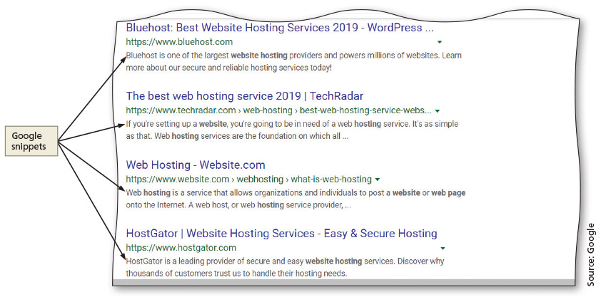
Meta Tags (continued 3)
Figure 11-31

Slide 24
Publishing a Website
After a website is developed, the next step is to register a domain name, determine a web hosting strategy, and publish the website
To do so, select and register a domain name, select a web hosting service, and then transfer the website files to the host’s server

Slide 25
Domain Name
Server name portion of a URL
Selected and registered domain names should represent the business
The .com top-level domain (TLD) name is preferred for businesses
An open TLD means that any person or entity can register with the domain name

Slide 26
Domain Name (continued 1)
To determine if the domain name considered is available, one can start the search at InterNIC, www.internic.net
The InterNIC website is operated by the Internet Corporation for Assigned Names and Numbers (ICANN) to provide information to the public regarding Internet domain name registration services

Slide 27
Website Hosting
Options to find a hosting service
Using a company that charges for website hosting services
Setting up and maintaining one’s own web server

Slide 28
Website Hosting (continued)
Several questions need to be answered once a web hosting service is selected:
What is the total cost?
How much space is available?
How fast is the connection speed?
How much total bandwidth transfer is available?
Is technical support provided?
Are tracking services provided?
After a web hosting service is selected, files need to be transferred to the host’s server

Slide 29
Publishing a Website
When a website is published, the website files are transferred to a web server
One way to upload files to a web server is to use a File Transfer Protocol (FTP) client program
An FTP client is a software that is used to transfer files from a computer to a server over the Internet

Slide 30
FTP Clients
Like other types of software, some FTP clients are free and some are for purchase
FileZilla is a free FTP option
FileZilla FTP client software is available for several OS platforms, including Windows, macOS, and Linux

Slide 31
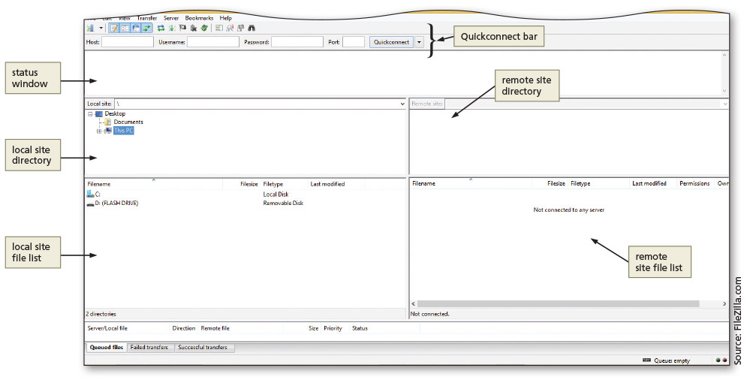
FTP Clients (continued 1)
Figure 11–39

Slide 32
Promoting a Website
After testing webpages and correcting any errors, the last step is to market the website location to attract visitors
Develop a comprehensive marketing plan
A website is a passive marketing tool; it serves no purpose if no one knows it is available on the web
To attract customers to your website, take appropriate steps to promote and market it

Slide 33
Promoting a Website (continued 1)
Methods of website promotion and marketing
Register website with search engines
Add business website to Google, Bing, and Yahoo
Advertise through social networking platforms
Post social media on a regular basis
Write a guest blog
Create a Google Ad
Add website to business cards, company brochures, stationery, and email signature
Advertise website through email marketing

Slide 34
Promoting a Website (continued 2)
Tell people you meet about your website
Negotiate reciprocal links in which you agree to link to a website if they agree to link to your website
Use newsgroups specific to your industry

Slide 35
Registering with Search Engines
A website is registered with a search engine after the meta tags are entered and the website is published and marketed
The two most popular search engines are Google and Yahoo!
It is also a good idea to register a website with search engines that specialize in subject matter related to the website

Slide 36
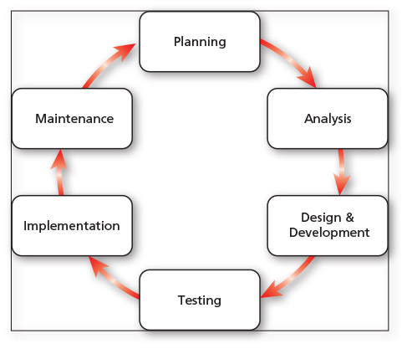
Website Development Life Cycle
Process that can be used for developing webpages at any level of complexity
Figure 11–47

Slide 37
Website Planning
First phase of the web development life cycle
Identifying the goals or purpose of the website, who will use the website, and computing environments of most users
Final aspect to the website planning phase is to identify the content owners and authors
Who owns and authors the information on the website?
Who decides content placement on the website?

Slide 38
Website Analysis
Involves decisions about the website content and functionality
To help define the appropriate website content and functionality, first identify the tasks that users need to perform
Define necessary content to facilitate those tasks and determine useful information for the users
Consider the processes required to support website features

Slide 39
Website Design and Development
Key considerations in website design
Defining how to organize web page content
Selecting the appropriate website structure
Determining how to use multimedia
Addressing accessibility issues
Designing pages for an international audience
Determining the best way to provide navigation on the website

Slide 40
Website Testing
Basic steps to test content and functionality
Validating each HTML page by running it through the W3C markup validation service
Validating your stylesheet by running it through the W3C CSS validation service
Proofreading page content and titles to review for accurate spelling and grammar
Checking links to ensure they are not broken and are linked correctly
Checking graphics to confirm they appear properly and are linked correctly

Slide 41
Website Testing (continued 1)
Ensuring that accessibility and internationalization issues are addressed
Testing forms and other interactive page elements
Testing pages to make sure they load quickly, even over lower-speed connections
Printing each page to view how each page looks when printed

Slide 42
Website Testing (continued 2)
Usability is the measure of how well a product, such as a website, allows a user to accomplish their goals
Usability testing is a method by which users of a website or other product are asked to perform certain tasks in an effort to measure the website’s ease of use and the user’s perception of the experience
Compatibility testing is done to verify that the website works with a variety of browsers and browser versions
Different browsers display some aspects of webpages differently

Slide 43
Website Testing (continued 3)
Stress testing determines what happens on your website when a significant number of users access the site at the time same
Verifies that a website runs at an acceptable speed with many users

Slide 44
Implementation
Once website testing is complete and any required changes have been made, the website can be implemented
Implementation of a website involves publishing the webpages to a web server
FTP software, such as FileZilla, can be used to publish webpages to a web server
After publishing a website, test the webpages again to confirm they have no obvious errors such as broken links or missing graphics

Slide 45
Maintenance
To help manage website maintenance, determine who is responsible for updates to content, structure, functionality, and so on
Limit update responsibilities to specific users
Be sure implementation is controlled by web developers who can verify webpages are tested thoroughly before publishing
Website monitoring is another key aspect of maintaining a website
Google Analytics and web hosting service providers offer invaluable data about website usage

Slide 46
Being an Observant Web User
As a web developer, review the webpages that you access with an eye on functionality and design
Bookmark websites you think are effective and ineffective, good and bad, and use them as references for your own web development efforts
Watch for trends on the web as you search for information or make online purchases

Slide 47
Project Management
A website project management team works together to plan, design, develop, publish, and maintain a website
Project manager oversees the entire project and maintains a timeline of project tasks and goals
Website designer creates the web design
Website developer develops the webpages
Content specialist develops webpage content
Marketing professional develops a marketing campaign
Server administrator maintains the web server

Slide 48
Content Updates
Updating website content is an ongoing process
When you have a new product or service, add an image or video to your website to showcase it
If your company submits press releases on a regular basis, create a page for press releases, as this shows that your business is active and busy
Consider a page for client testimonials to spur potential sales
Post social media on regular basis

Slide 49
Copyright Law
Think twice before downloading media to use on your website
The person who created the media is its owner
There are times when it is acceptable to use media created by another source
Fair use pertains to the use of copyrighted material without the need for permission from the creator
Creative Commons licenses provide media content authors the ability to share work with others, while maintaining ownership

Slide 50
E-Commerce
Online businesses that conduct transactions online, including large, retail websites that sell products to consumers
A booming business: online customers enjoy purchasing what they want, when they want it and store-front overhead costs are reduced
Also has its obstacles: identity theft and fraud

Slide 51
Chapter Summary
In this chapter, you learned how to:
Add social media icons and links to a webpage
Improve SEO for a website by improving page titles, adding description meta tags, and creating a sitemap file
Publish and promote a website
Make webpages more accessible by creating a Skip to Content link
Improve page loading time by minifying a CSS file

